Slide 1
Python Essentials

Slide 2
Learning Objectives
Complete setup of a work environment using Anaconda and Jupyter notebook
Identify the important built-in data types for Python
Discuss often-used data structures, such as lists and dictionaries
Illustrate more sophisticated and selective access in data structures with slicing
Describte basic operators and functions
Demonstrate basic control structures in Python

Slide 3
1. Jupyter Notebook
Jupyter is an open source and interactive web-based interface to Python, which is widely used for scientific computing and data science
It provides a simple, effective means of sharing content and code
Installation – first make sure Anaconda is installed
Getting started

Slide 4
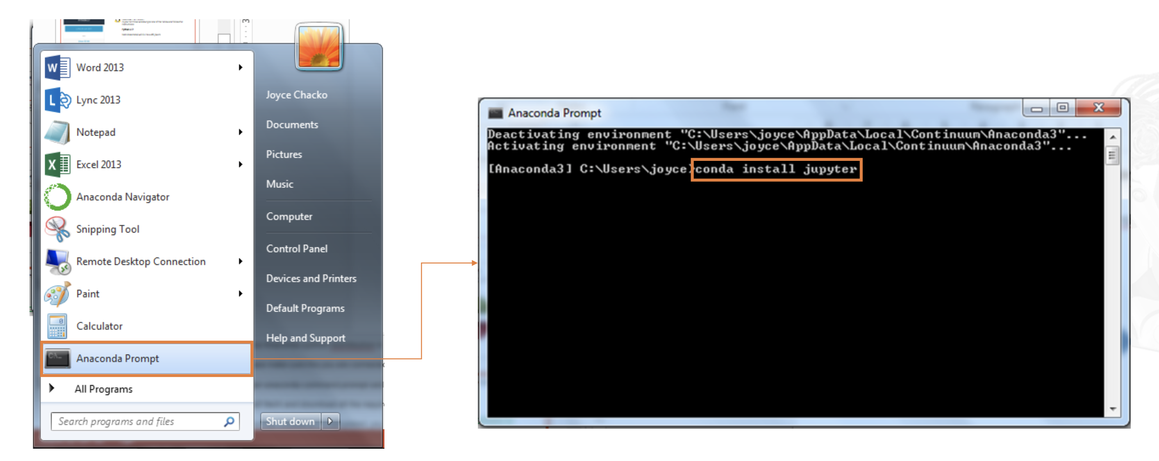
Jupyter Notebook: Installation (Windows)
Launch Anaconda Prompt
Within Anaconda Prompt, install Jupyter Notebook using the command shown and press Enter

Slide 5
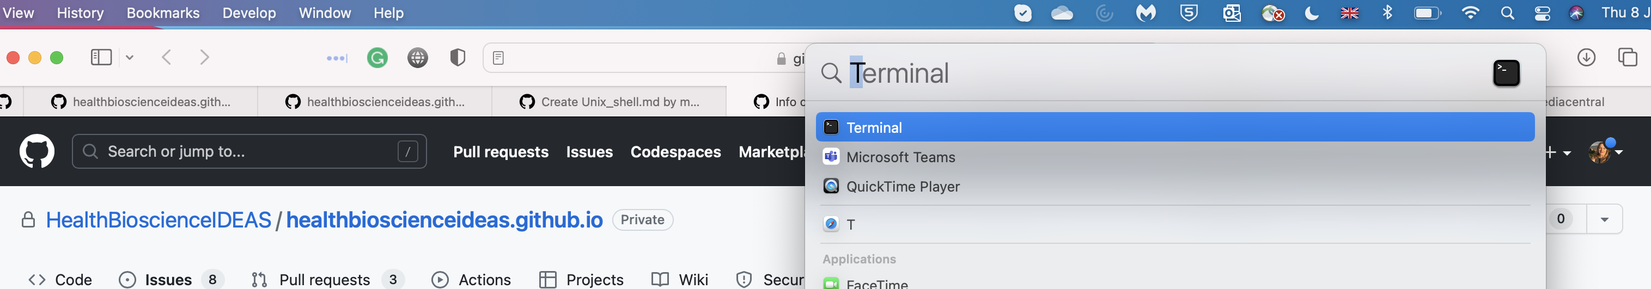
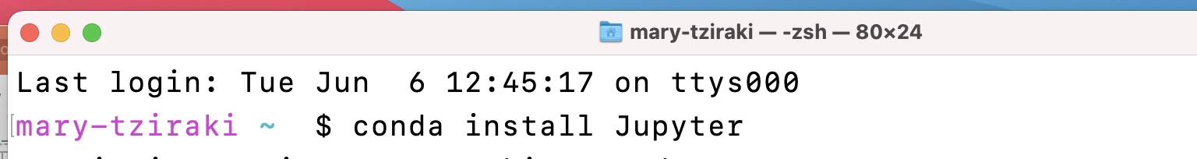
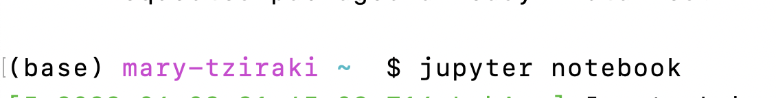
Jupyter Notebook: Installation (MacOS)
Open the Terminal application.
In the terminal window, type the following command: conda install jupyter
When Jupyter is installed type the command : jupyter notebook
Step 1: Search for the Terminal Application
and open the terminal
Step 2: If you are doing it for the first time
Install Jupyter via anaconda
Step 3: this command opens a Jupyter window on your web browser

Slide 6
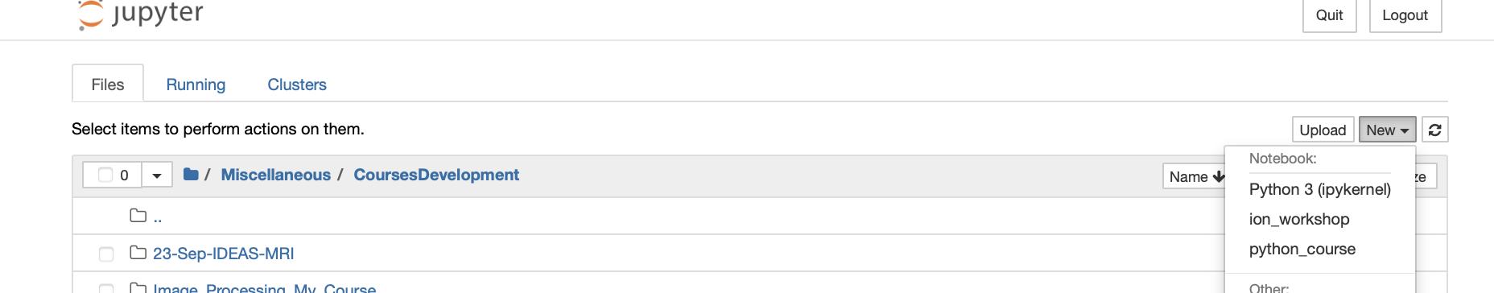
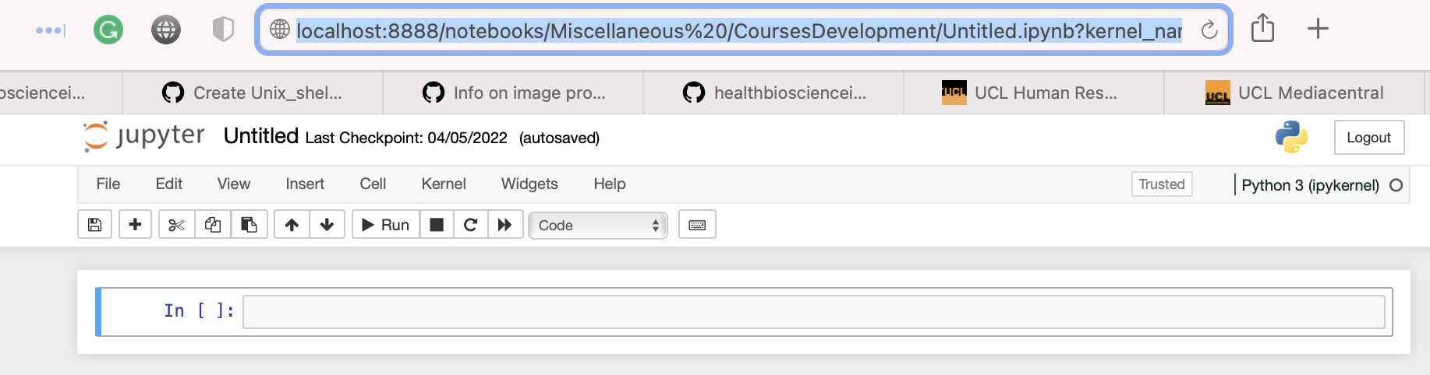
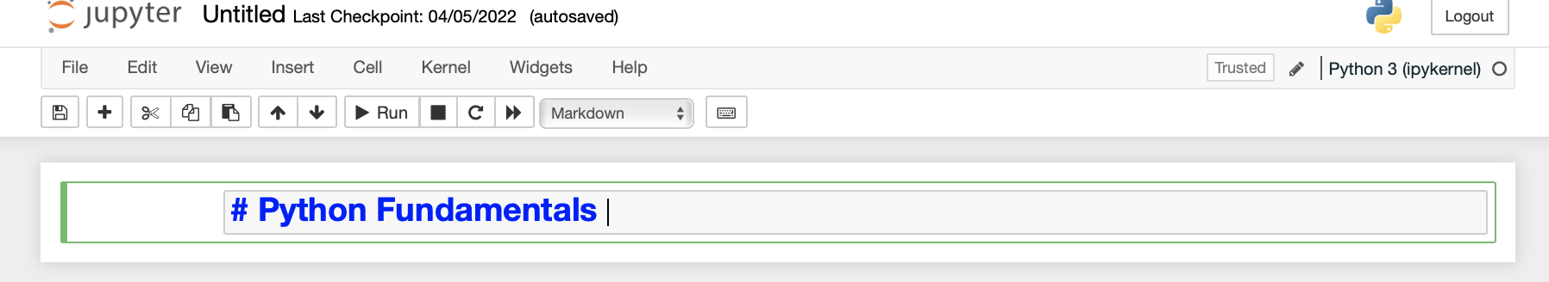
Jupyter Notebook: Launching
The interface opens and you select
New and Python 3 as language
The new Jupyter notebook is launched
as a web page in your browser
The cell could be for :
Code and for Markdown
Select Markdown and write headers
Starting with #
For normal text just write on the cell

Slide 7
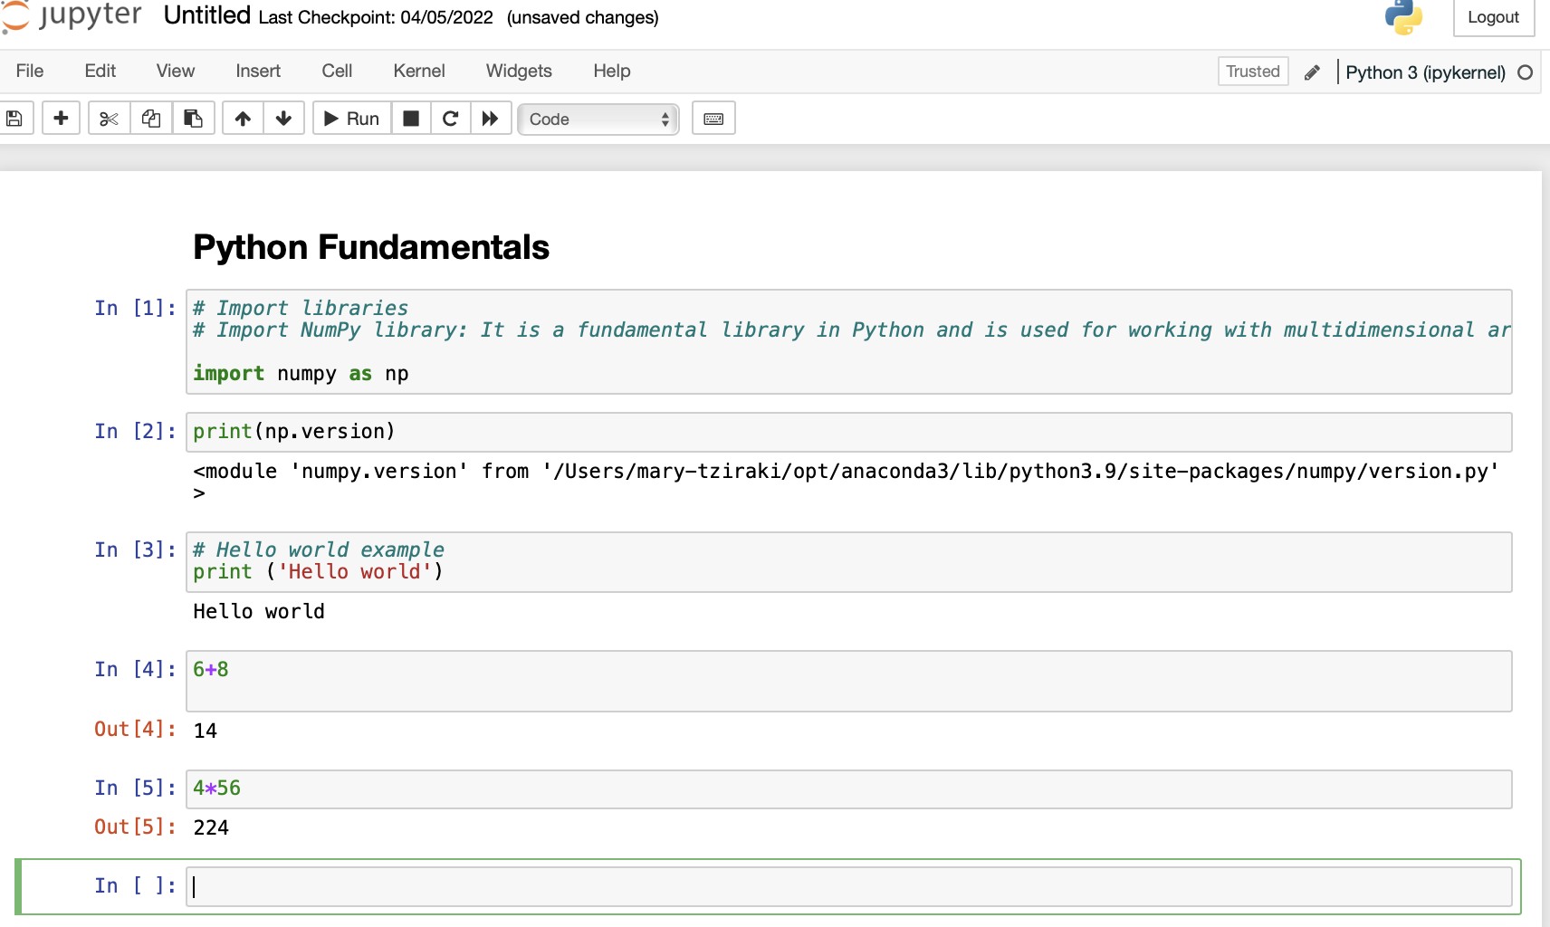
Getting Started
Execute the cell with (Shift+ Enter)

Slide 8
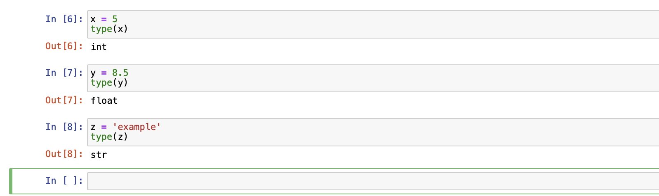
Variables
A variable can be assigned to any value. Some of the characteristics are
The variable refers to the memory location of the assigned value.
The variable appears on the left while the assigned value appears on the right
The data type of the variable and the assigned value is the same

Slide 9
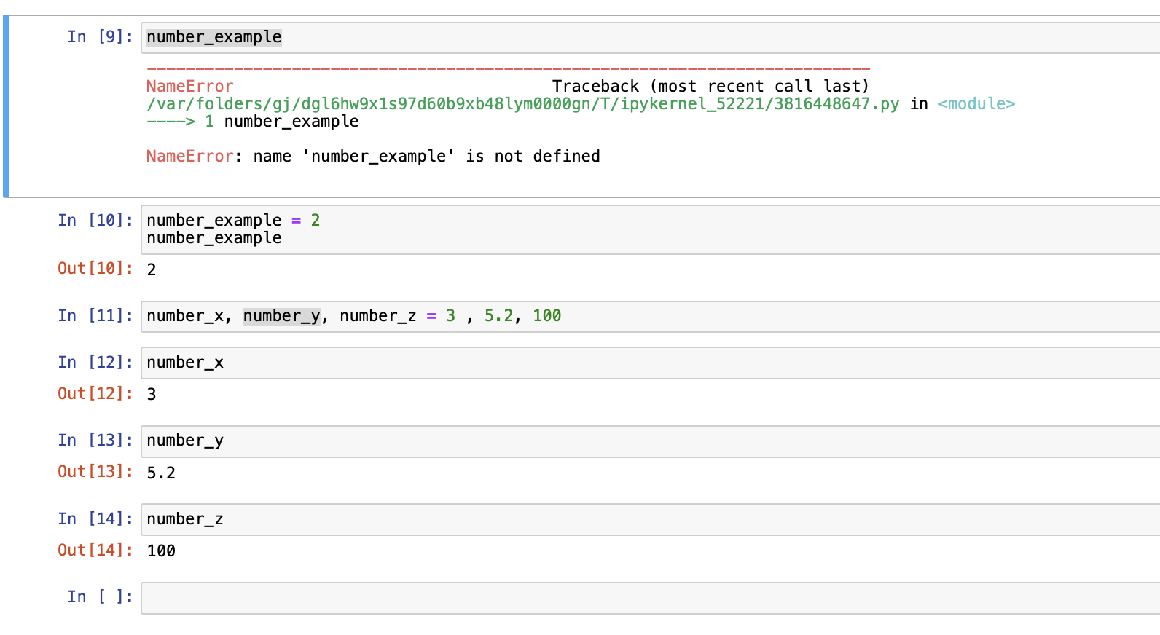
Multiple Assignments
You can access a variable only if it is defined. You can define multiple variables simultaneously
Access a variable without assignment ends to error!
Access a variable with assignment
Access a variable with multiple assignments

Slide 10
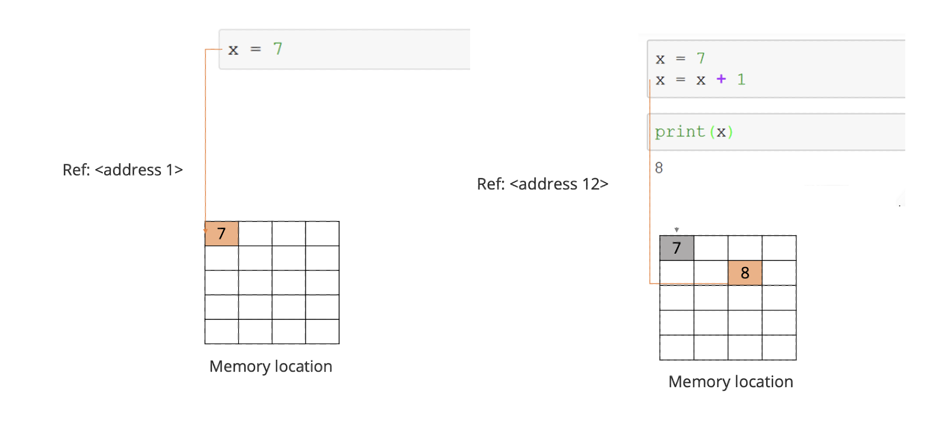
Assignments and Reference
When a variable is assigned to a value, it refers to the value’s memory location or address.
It doesn’t equal to the value itself.

Slide 11
2. Data types and structures
Numeric: Integers and float
Strings
Boolean
Type casting

Slide 12
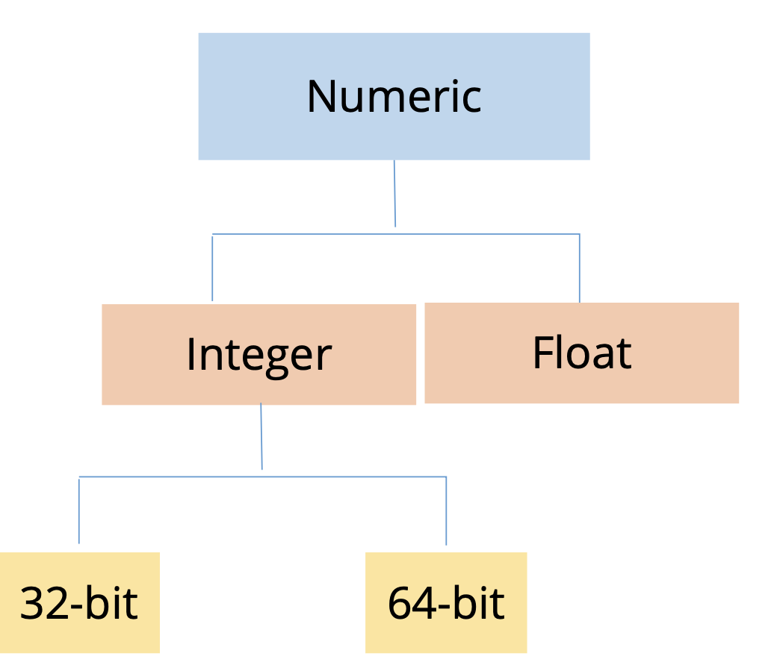
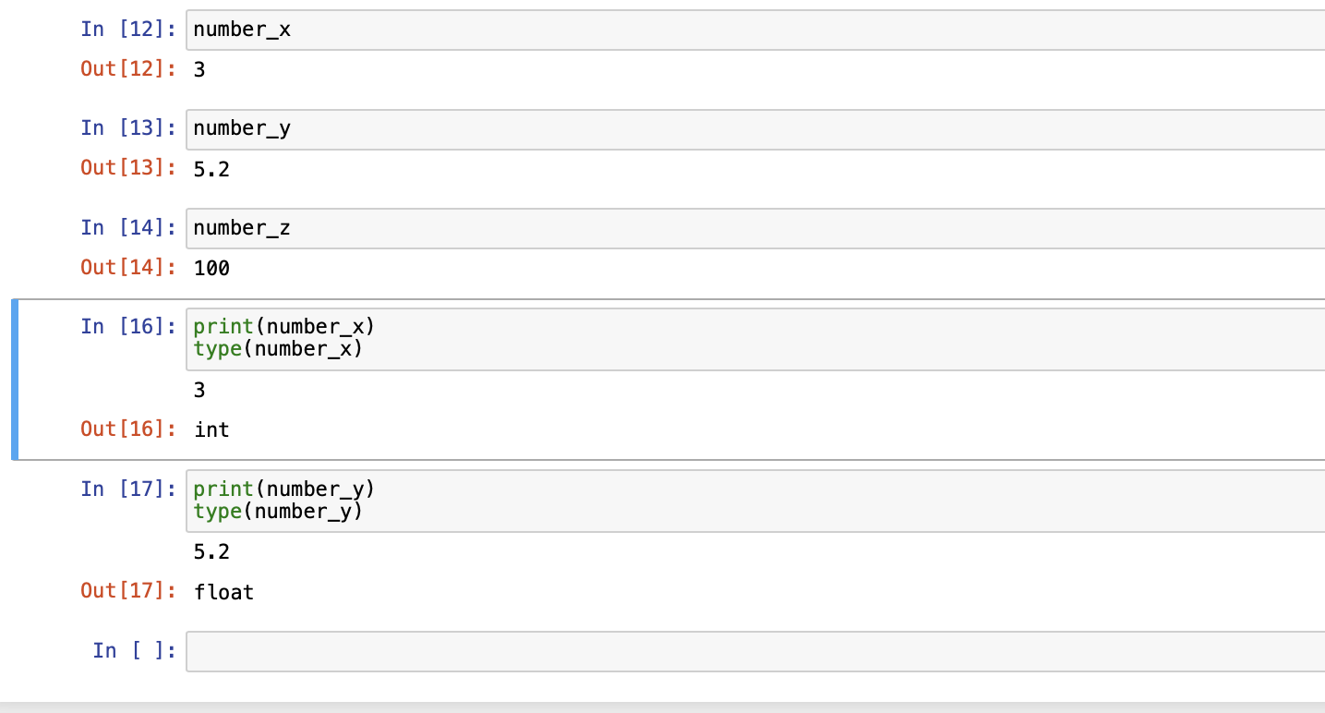
Data Types: Numeric
There are two numeric data types: integers and floats

Slide 13
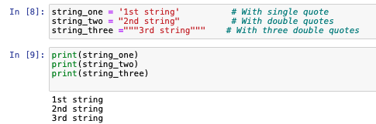
Basic Data Types: Strings
Python has powerful and flexible built-in string processing capabilities.
Strings

Slide 14
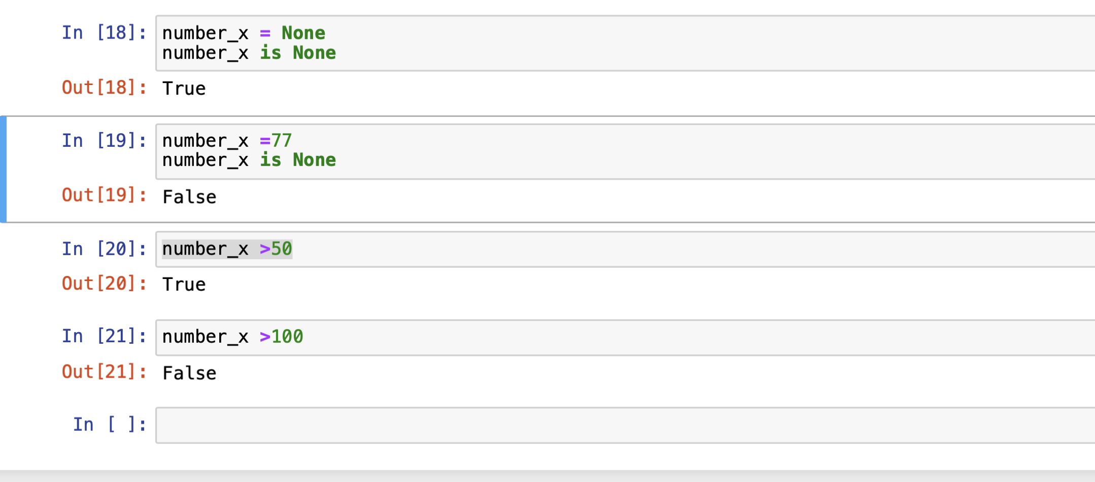
Basic Data Types: None and Booleans (True or False )

Slide 15
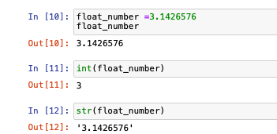
Type Casting
You can change the data type of a number using type casting. Use int(x), of float(x) or str(x) to change type
A Float number
Type cast to integer
Type cast to string value

Slide 16
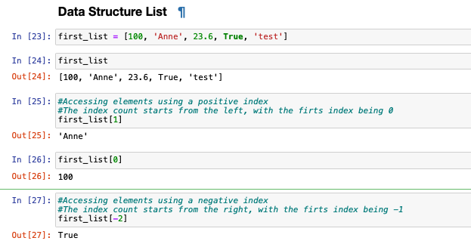
3. Data Structures : Lists and Dictionaries
Lists: A list is one-dimensional sequence of items which can be of mixed data types.
Create a list
View the list
Access the data with positive index value 1
Access the data
at negative index value -2

Slide 17
3.1 Lists
Create a list
Print the list.
Access elements of the list using indices
Modify list (add new items, remove items)
Slicing lists (using indices to get a subset of the list)

Slide 18
Create a list
View the list
Access the data with positive index value 1
Access the data
at negative index value -2

Slide 19
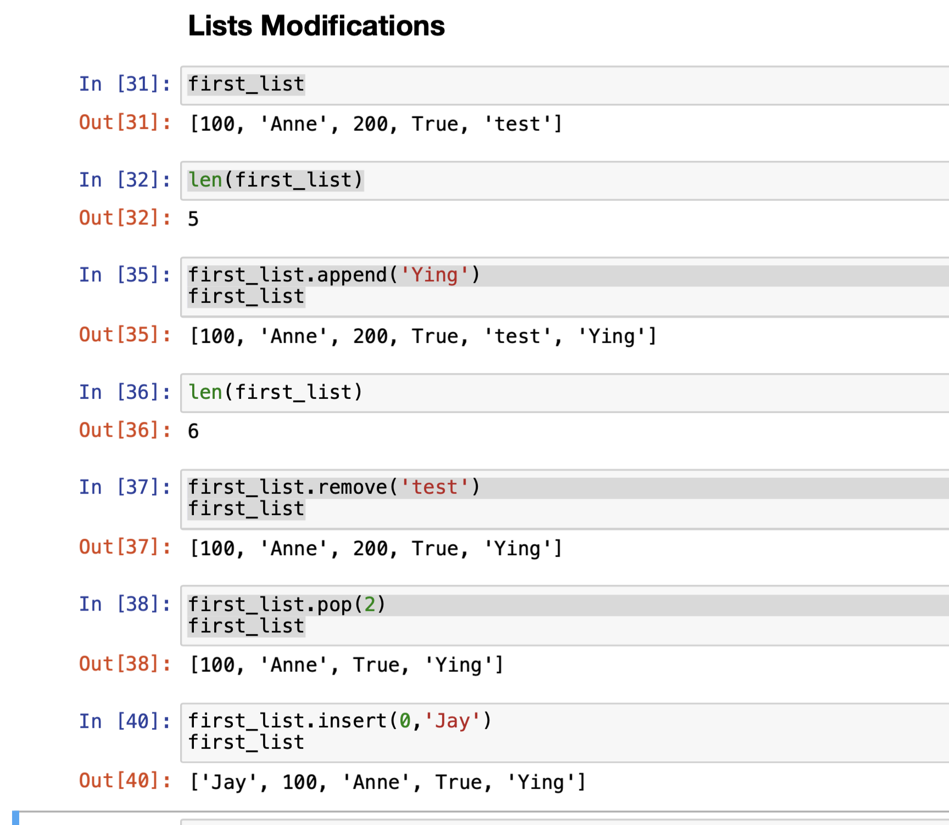
Check the length of the list
Add new elements in the end
Remove item
Access and remove items using indices
Insert a new item at a certain index

Slide 20
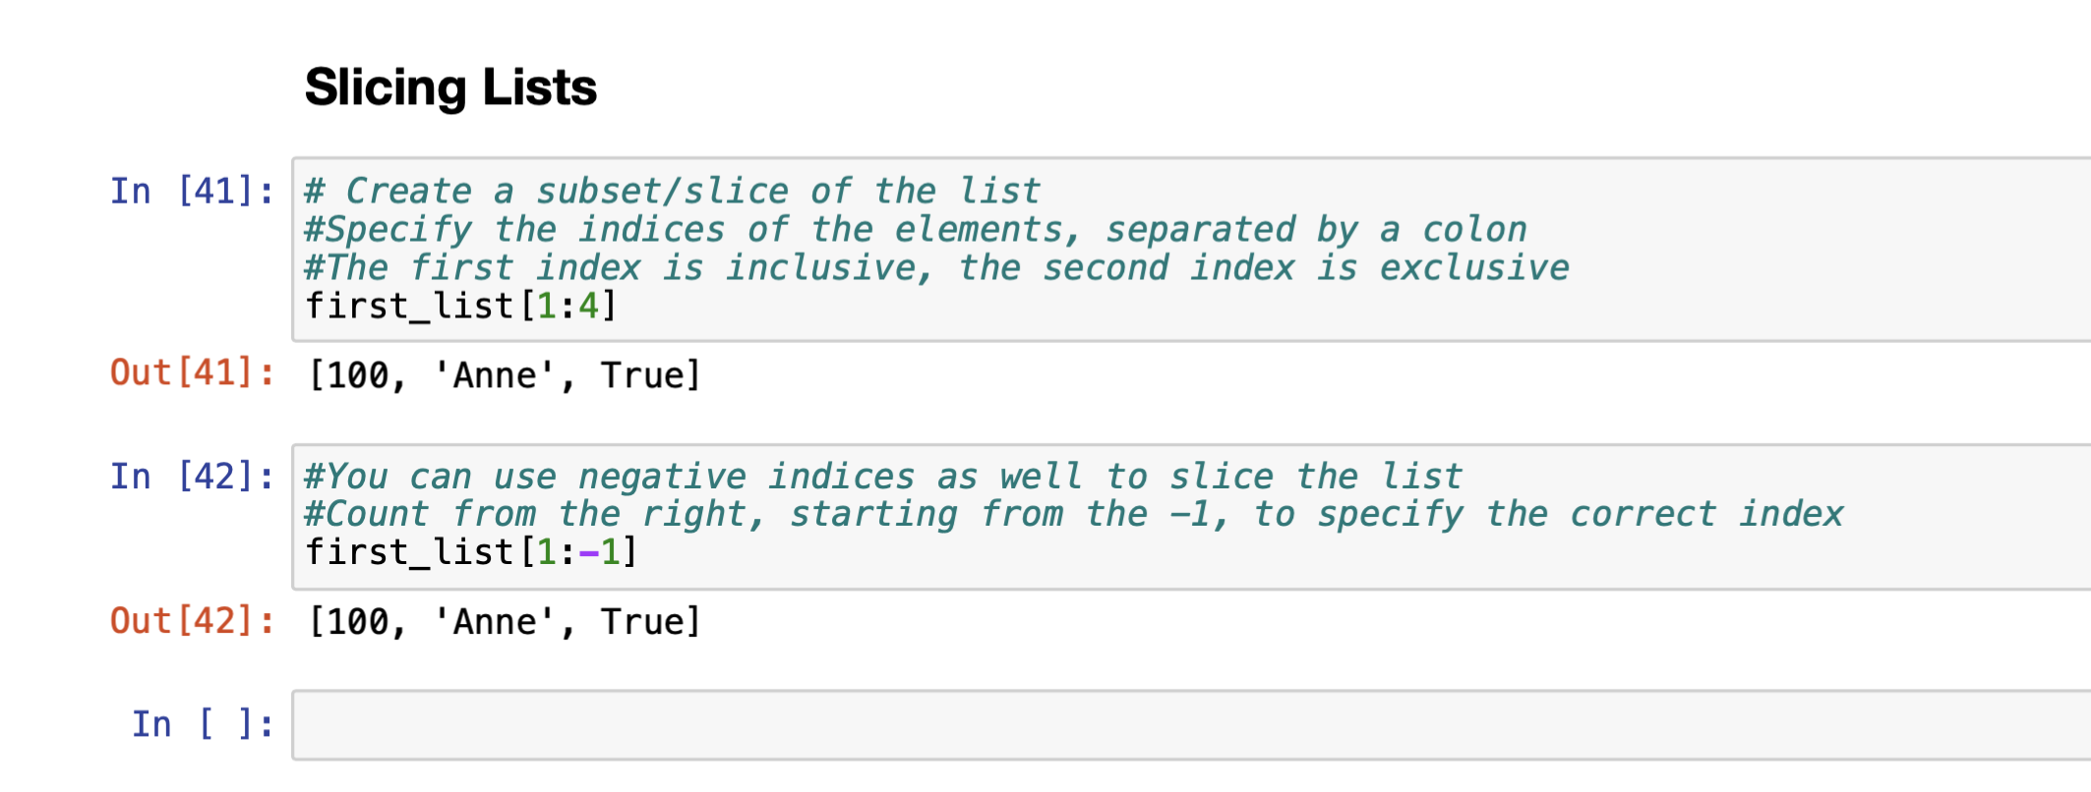
Data structure: Slicing Lists
We can slice lists through indices
Count starts with the first index but stops before the second index
Even with the negative indices the counts stops before the second index

Slide 21
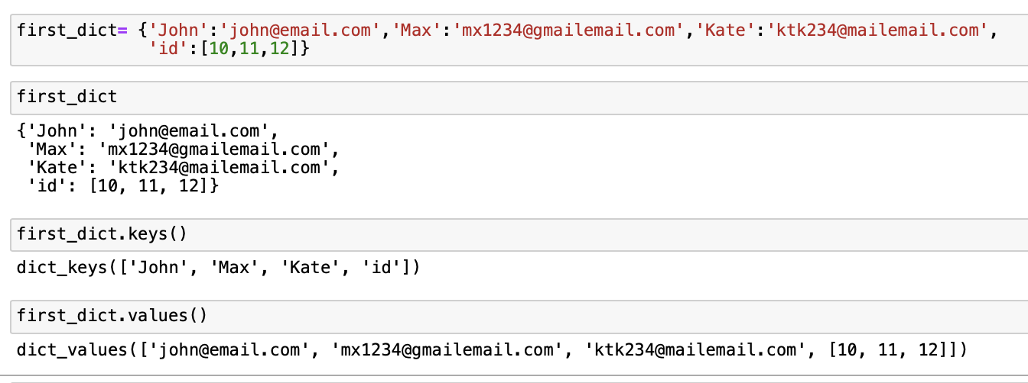
3.2 Data Structures: Dictionary (dict)
Dictionaries store a mapping between a set of keys and a set of values.
The keys are any immutable type and the values are any data type.
The dictionary is within curly brackets { } and the keys and values are separated by a colon (:)
Create the dictionary
Show the dictionary
Display the keys
Display the values

Slide 22
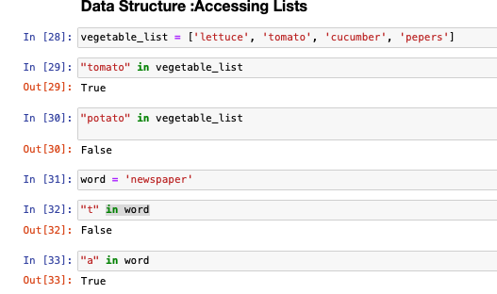
4 Basic Operator: in
The in operator is used to generate a Boolean value to indicate whether a given value is present in the container or not.
Create a list
Test presence of string
with in operator
Create a string
Test presence of a letter
with in operator

Slide 23
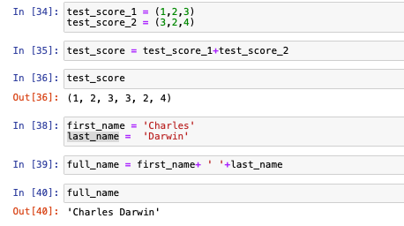
Basic Operator: +
The plus operator is used to concatenate (combine) lists or strings together

Slide 24
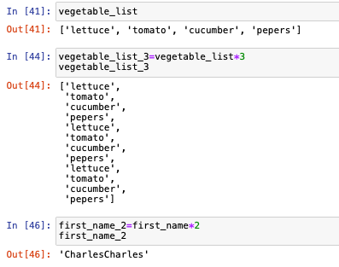
Basic Operator: *
The * operator produces a new list, or string that repeats the original contents by the number of times

Slide 25
5. Functions
Functions are the primary and most important method of code organisation and reuse in Python
Syntax
def<function_name>(arg1, arg2, …,argN): <statements> return<value>
Properties
Outcome of the function is communicated by a return statement Arguments in parenthesis are passed in when the function is called

Slide 26
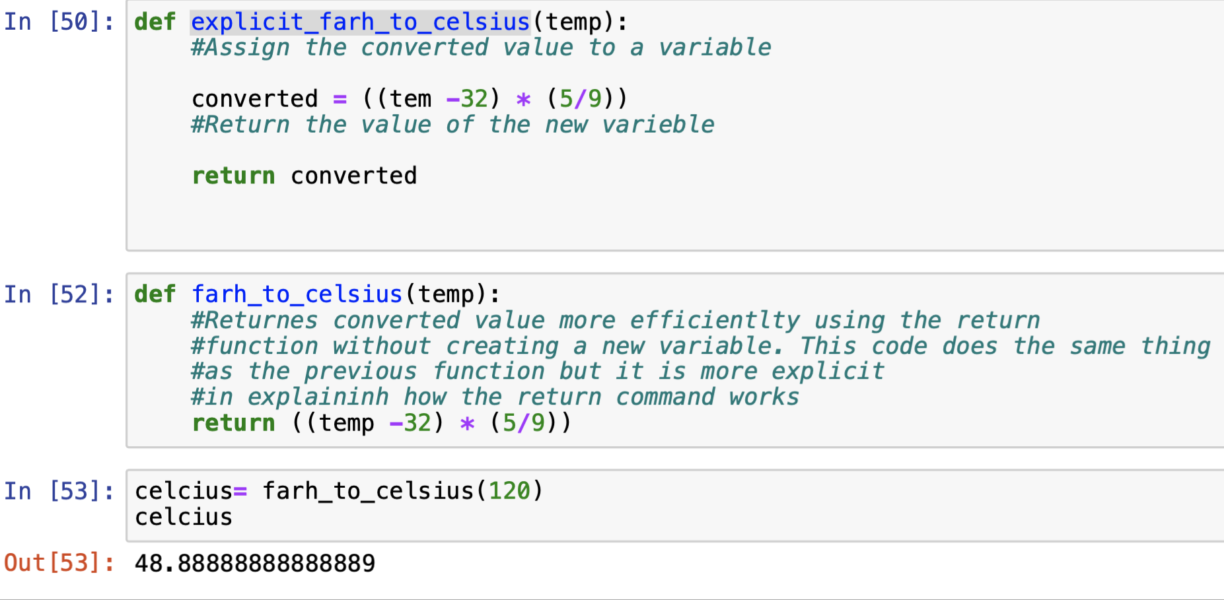
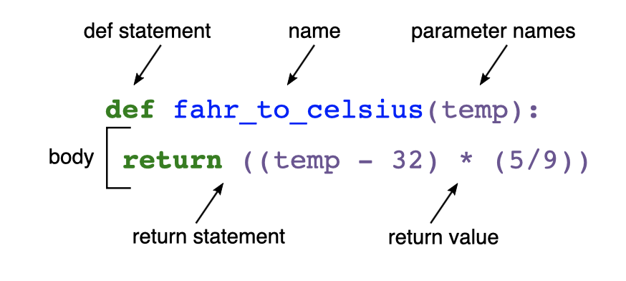
Functions:
Create function
A function should always have a return value
If return is not defined, then it returns None
Create function
Call function

Slide 27
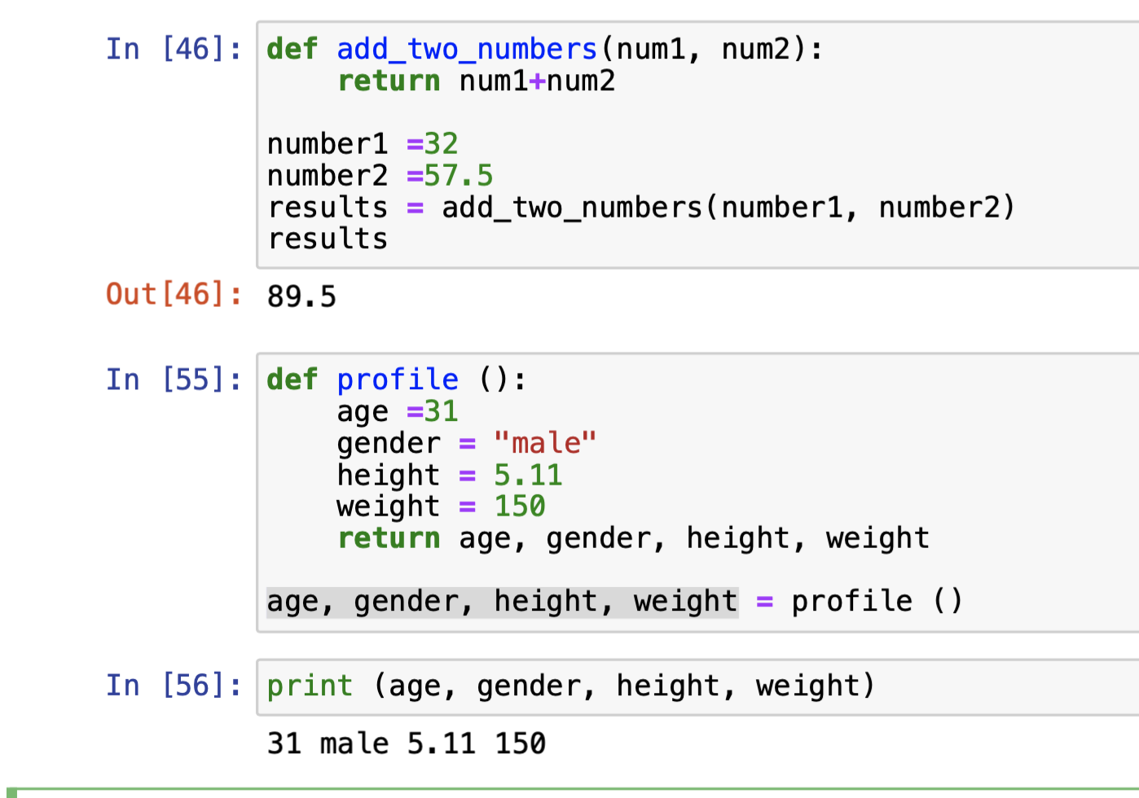
Functions: Returning Values
You can use a function to return a single value or multiple values
Create function
Call function
Create a new function
Call function
Multiple returns

Slide 28
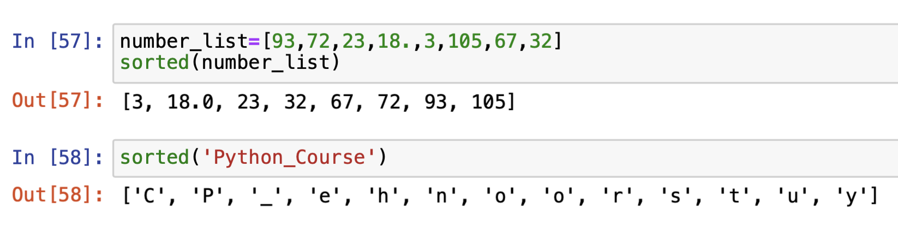
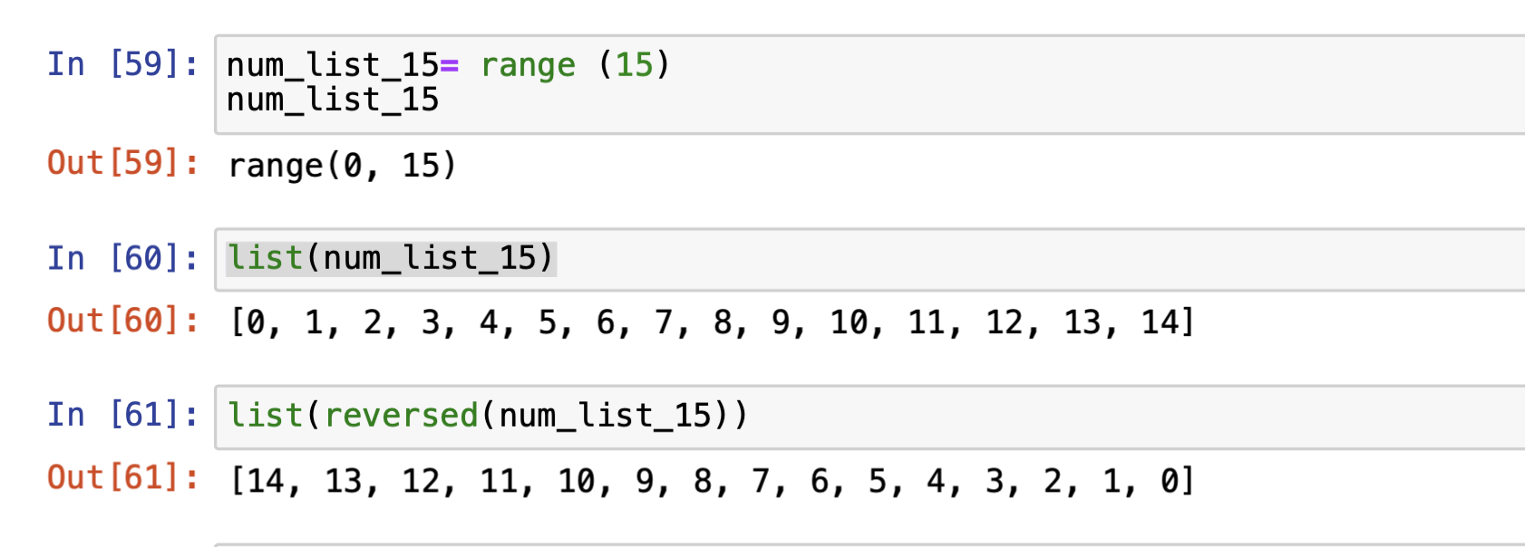
Build- in Sequence Functions:
Sorted: returns a new sorted list for a given sequence ( which might be a list or a string)
reversed: returns iterated data in reverse order
Creates a range up to 15
Makes the range a list
Returns the reverse order

Slide 29
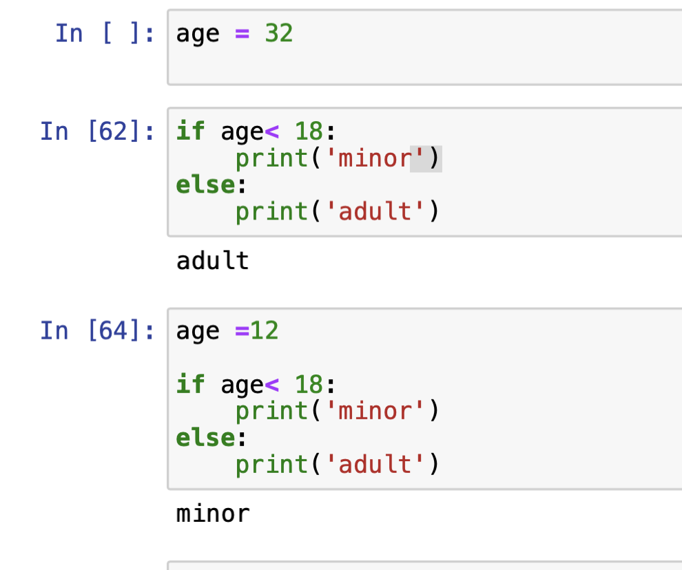
6 Conditional statements: if, elif, else
The if, elif, and else statements are the most commonly used control flow statements
If condition
Else Block

Slide 30
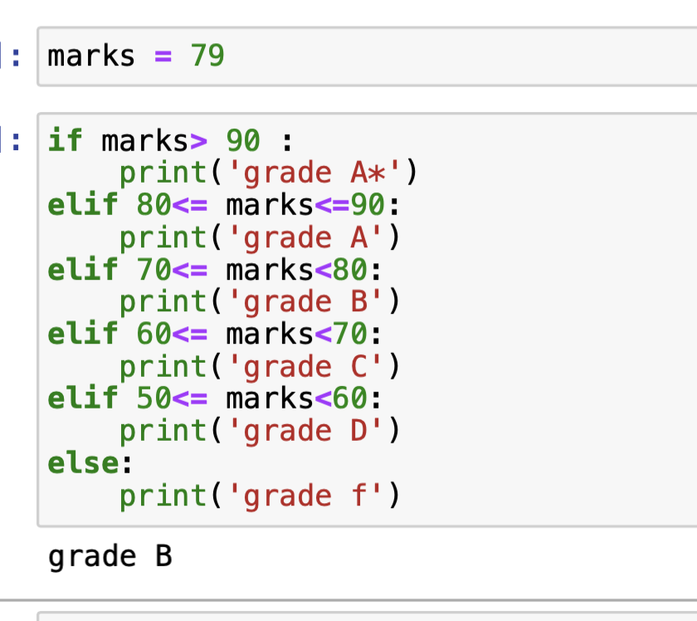
6 Conditional statements: if, elif, else
Nested if, elif and else

Slide 31
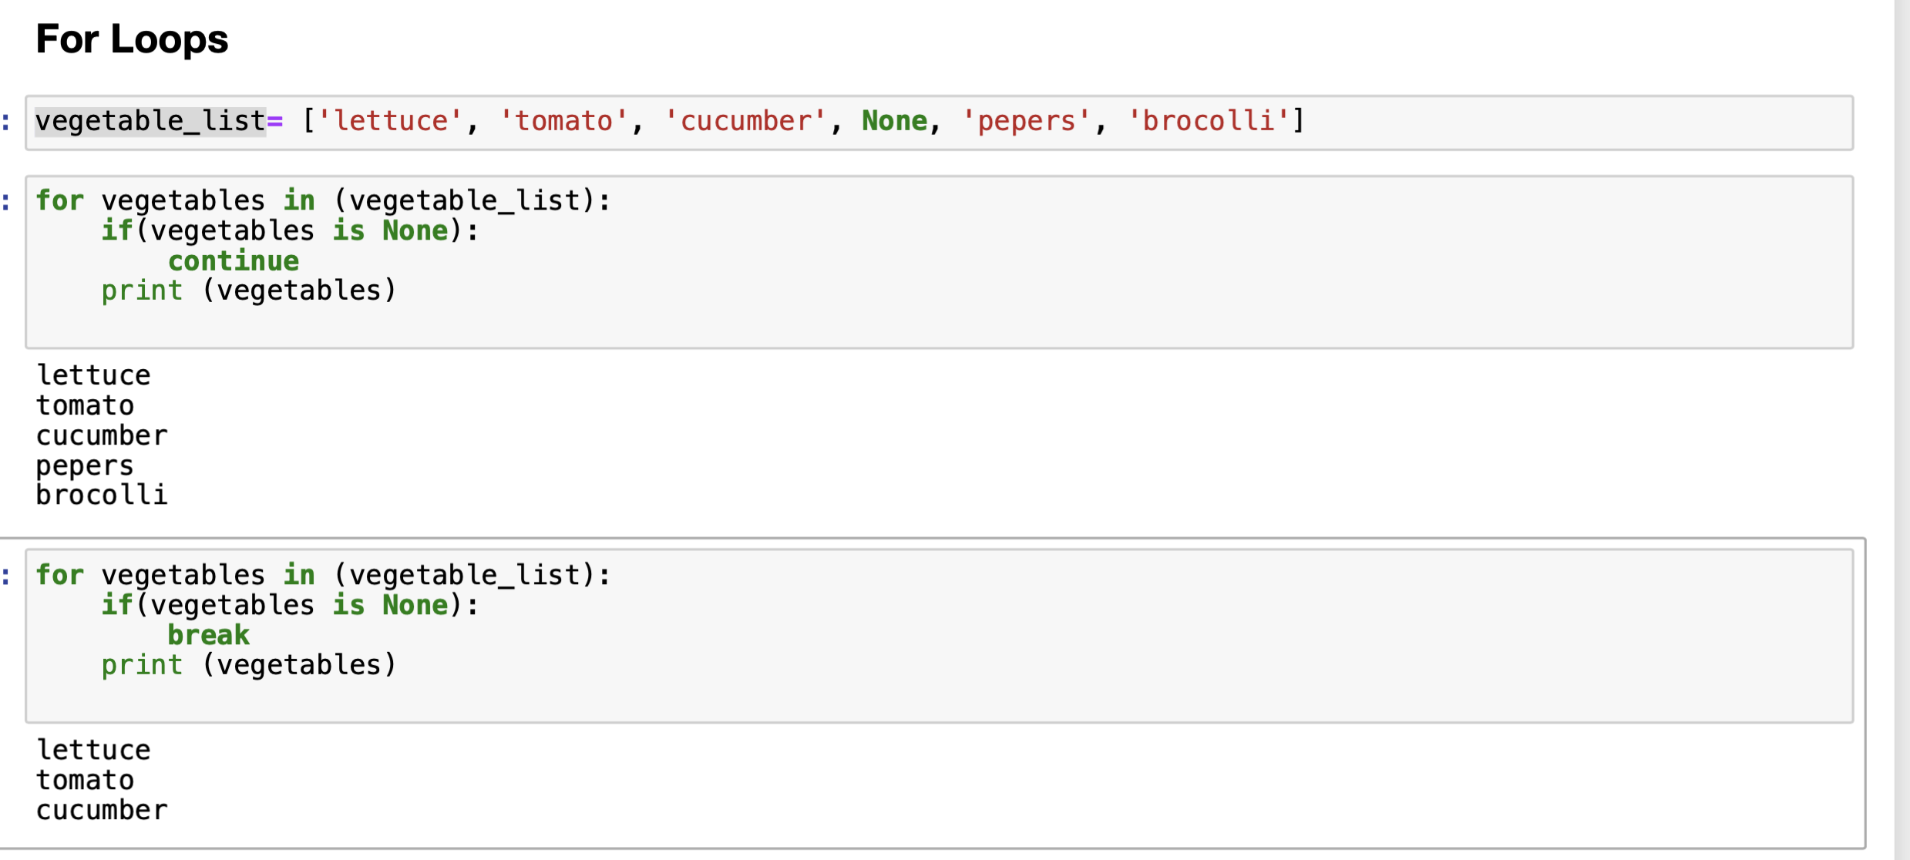
7. Control Statements: for Loops
A for loop is used to iterate over a collection (like list ) or an iterator
For loop iterator
Continue statement
Break statement

Slide 32
Learning Objectives
Complete setup of a work environment using Anaconda and Jupyter notebook
Identify the important built-in data types for Python
Discuss often-used data structures, such as lists and dictionaries
Illustrate more sophisticated and selective access in data structures with slicing
Describte basic operators and functions
Demonstrate basic control structures in Python

